Slide 1
Failure Unfiltered: Stories of Vulnerability and Lessons Across Career Stages
Amanda J. Shallcross, ND, MPH (moderator)
Shelley Adler, PhD
Paula Gardiner, MD, MPH
Jolaade Kalinowski, PhD
Peter Wayne, PhD
March 5, 2025
Notes:
Session time: 1 hour, start time 10am PT

Slide 2
Disclosure
The authors of this presentation have no conflicts of interest to disclose.
Notes:
3 min (prob won’t start *right* on time): 10:03am

Slide 3
Panel Discussion Outline
Review Learning Objectives
Introduction to Panelists
Questions to Panel from Moderator
Questions to Panel from Audience
Notes:
1 min: 10:03-10:04am

Slide 4
Learning Objectives
Attendees should be able to describe strategies to cope with failure and identify examples of their application.
1
Attendees should be able to be able to appraise their career path and implement strategies for success.
2
Attendees should be able to evaluate and strategize how their research and/or skills converge with what is most needed in the field of integrative medicine.
3
Notes:
2 min: 10:04-10:06am

Slide 5
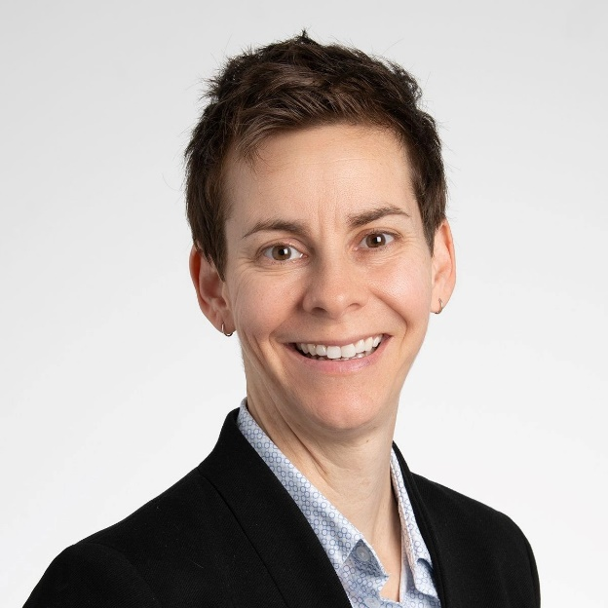
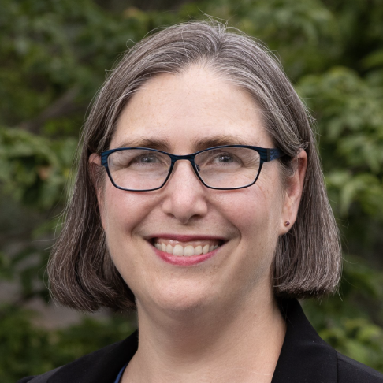
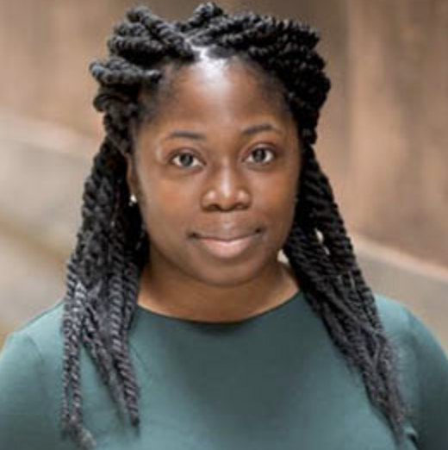
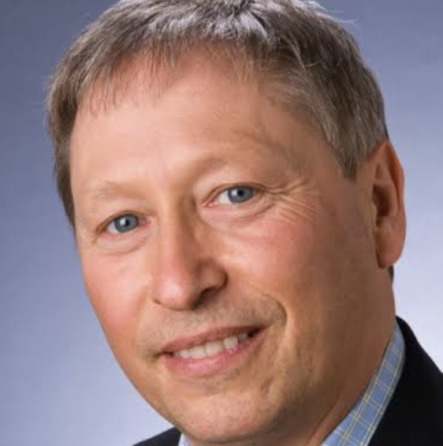
Panelists
Amanda J. Shallcross, ND, MPH (moderator)
Shelley Adler, PhD
Paula Gardiner, MD, MPH
Jolaade Kalinowski, PhD
Peter Wayne, PhD
Professor
Director
Osher Center for Integrative Health
UCSF
Associate Professor
Director of Primary Care Implementation Research
Cambridge Health Alliance
U. Mass Chan Medical School.
Assistant Professor
Department of Human Development and Family Sciences
U. Of Connecticut
Associate Professor
Director
Osher Center for Integrative Health
Brigham and Women’s Hospital and Harvard Medical School
Associate Professor
Vice Chair of Research
Department of Wellness and Preventive Medicine
Cleveland Clinic
Notes:
4 min: 10:06-10:10am

Slide 6
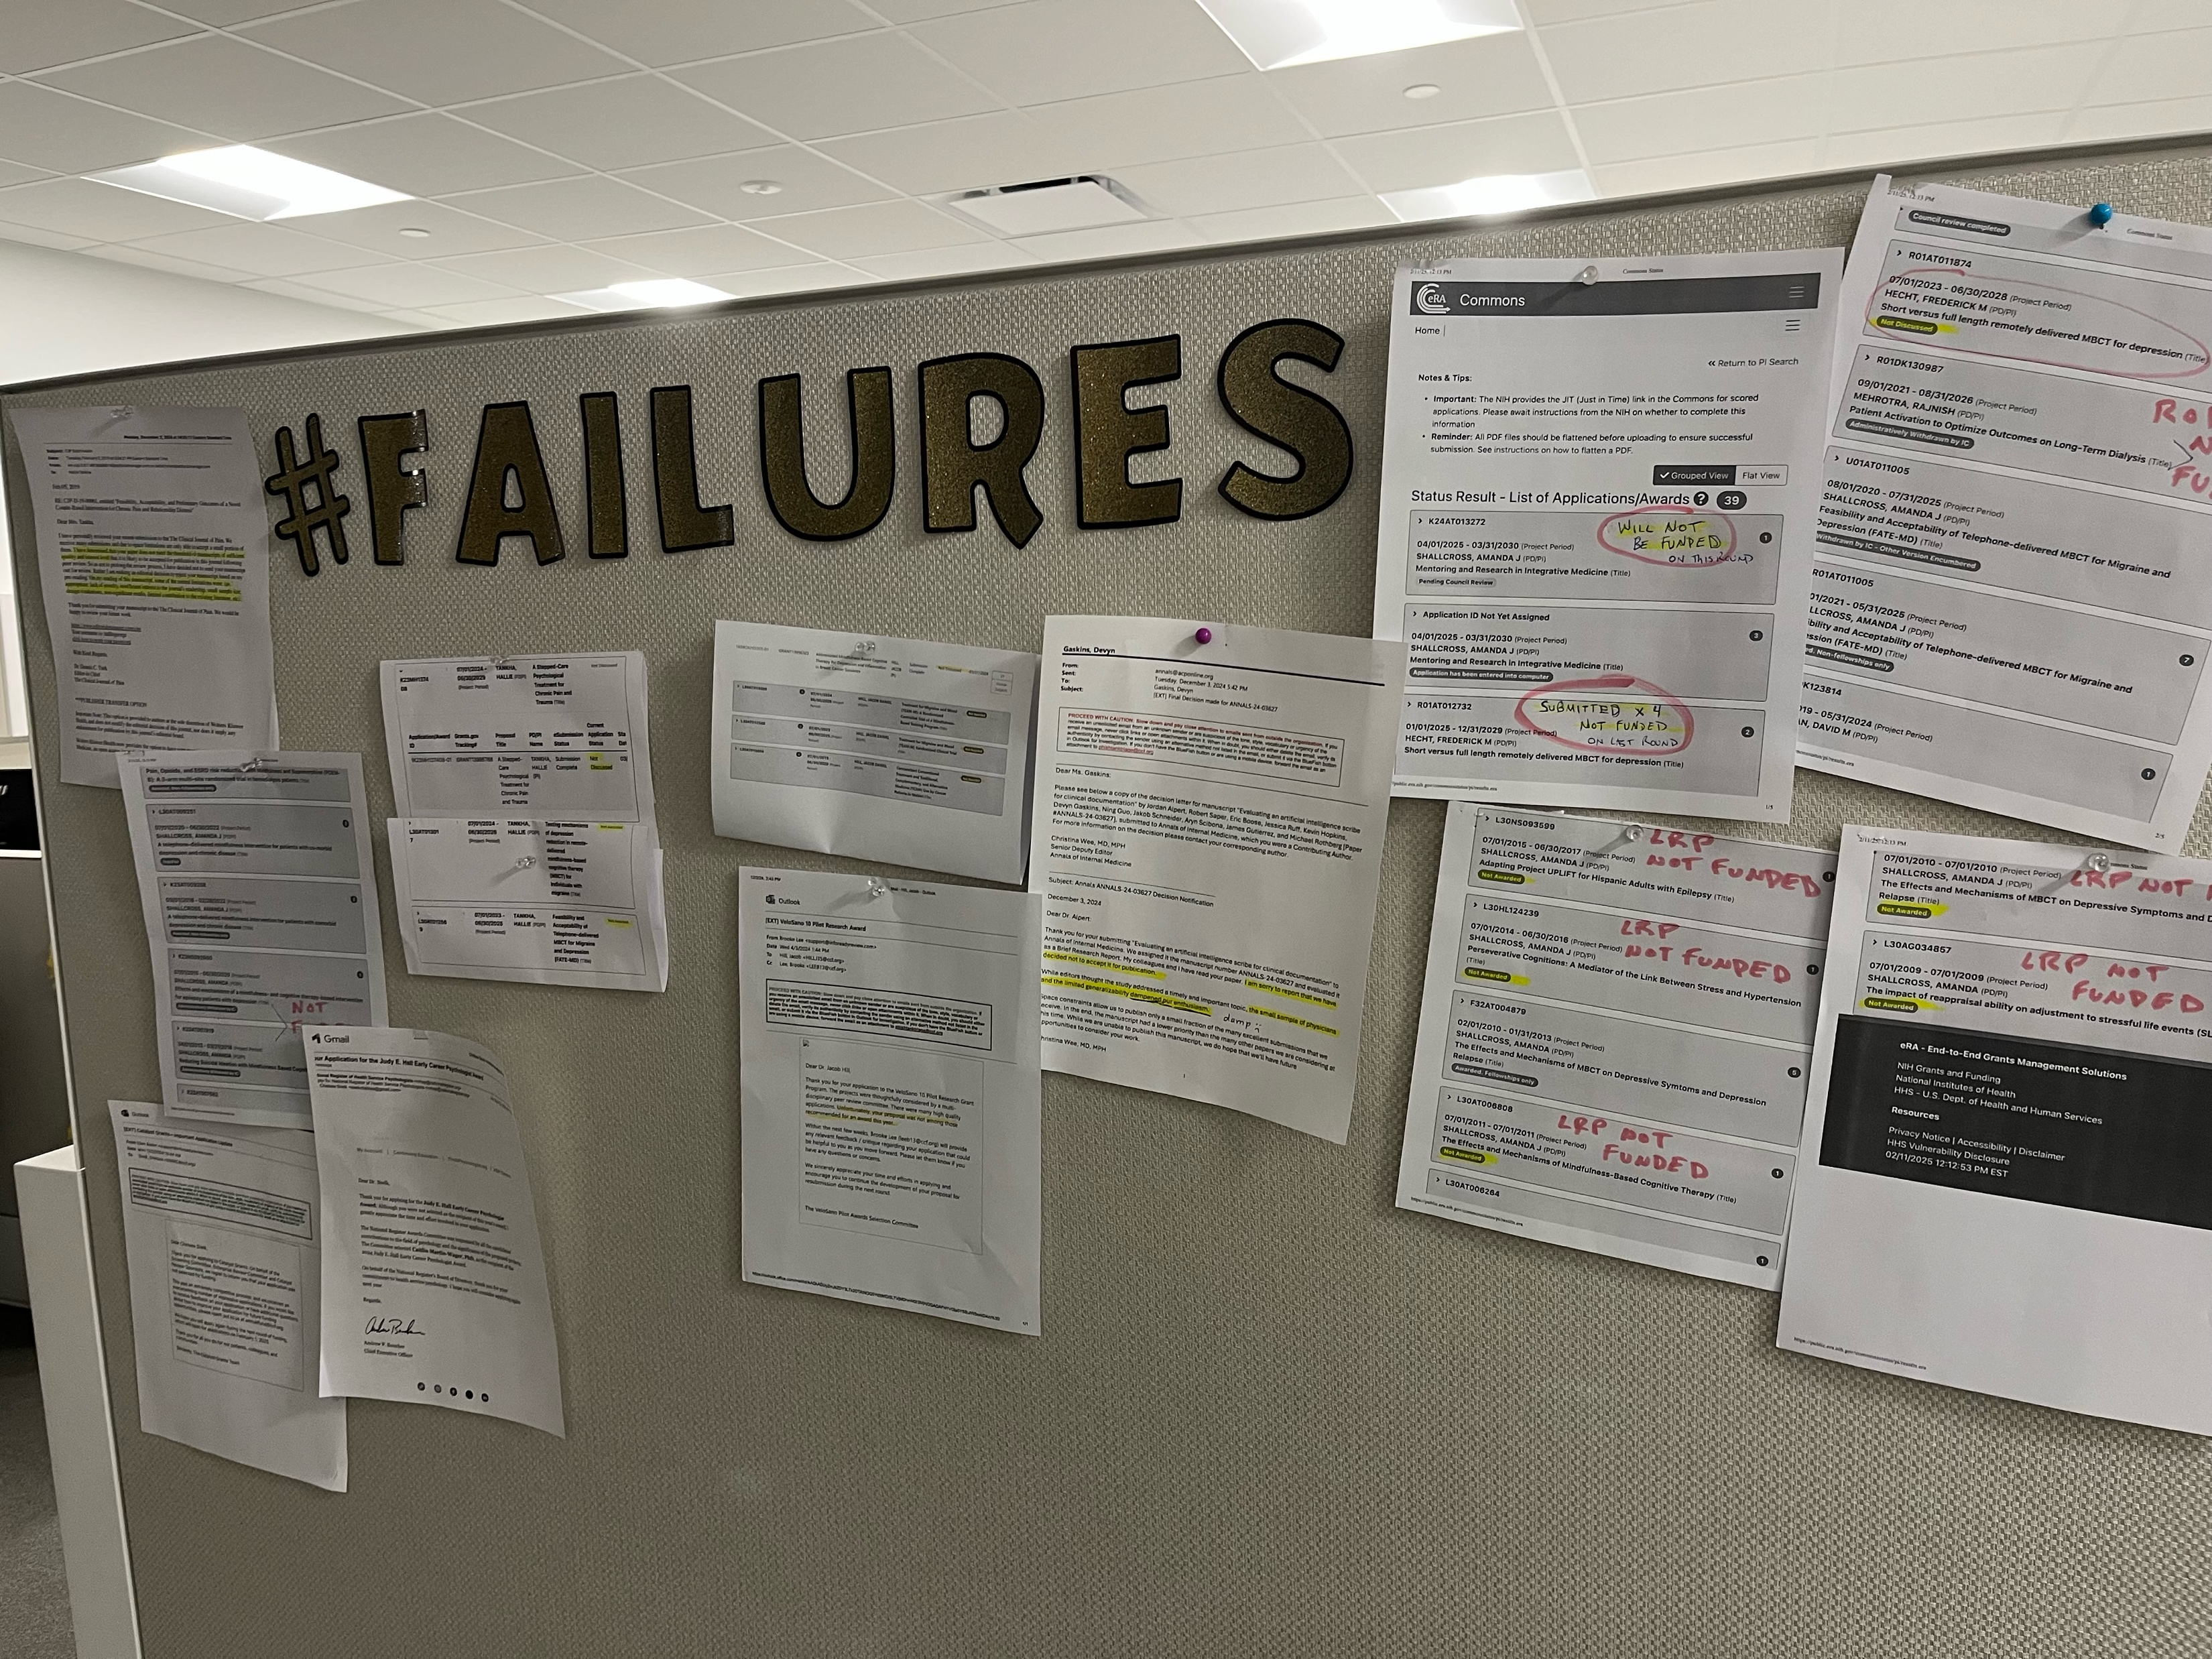
Background
Notes:
3 min: 10:10-10:13 AJS to discuss background/context for session.

Slide 7
Background
Notes:
3 min: 10:10-10:13 AJS to discuss background/context for session.

Slide 8
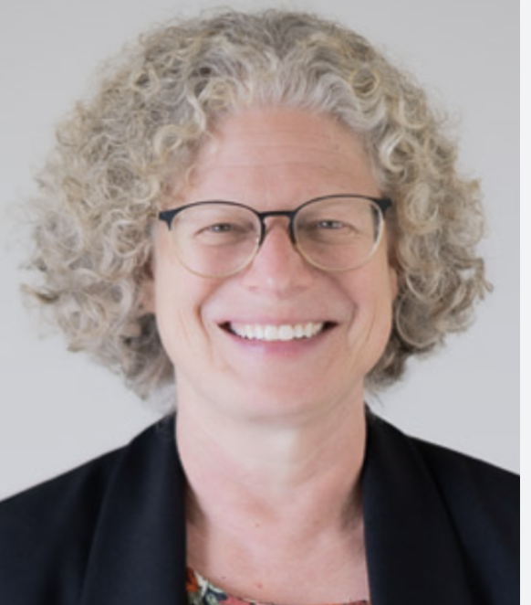
Question (1/6)
Describe current role and what you like the most and least about your positions?
Notes:
8 min (2 min each * 4): 10:13-10:21am

Slide 9
Question (2/6)
Describe one of your failures and something that has made you embarrassed or ashamed.
Notes:
4 min (2 min each): 10:21-10:25am

Slide 10
Question (3/6)
What would you do differently if you could restart your career?
Notes:
4 min (2 min each): 10:25-10:29

Slide 11
Question (4/6)
What strategies have you used to cope with failure? What would you recommend to others to cope with failure?
Notes:
6 min (2 min each): 10:29-10:35am

Slide 12
Question (5/6)
What single piece of advice would you give to someone just starting their career?
Notes:
4 min (2 min each): 10:35-10:39am

Slide 13
Question (6/6)
What do you see is the biggest challenge in the field right now in the areas of research, clinical care, and education?
Notes:
6 min (2 min each): 10:39-10:45am

Slide 14
Q&A Session
Audience: What questions do you have for our panelists?
Notes:
15 min (10:45-11:00)

